Slide 1



Slide 2
Density Based traffic signal Controller
Group Members
1) Gulfraz 2) Muhammad Sanaullah Kayani
FA16-BCS-009 FA16-BCS-035
Program
BS-Computer Science
Supervisor
Mr. Rehan Tariq

Slide 3

Outlines
Project Introduction
Objectives
Proposed Solution
Tool And Technology
Functional Requirement
Non-Functional Requirement
Working
Project Design & architecture
User Interface
Conclusion

Slide 4
Introduction
Density base traffic signals
Using Mega2560,IR sensor, WeMos Wi-Fi
Traffic Control room
Analyze signal flow through screen
Switch signal mode(fix or density mode)
Emergency Tackle App
Provide an ease for vehicles flow.

Slide 5
Objectives
Flow of traffic signal in an efficient way
A mechanism in which traffic signal is control according to traffic strength.
The main purpose of our project is to reduce the time delay at intercept.
Reduce congestion.
Visualize the signal flow
Tackle Emergency
Easy convenience to handle.
Ease for traffic controller
Fully automatic

Slide 6
Proposed Solution
Traffic controller enable to operate the signal through screen
Through Wi-Fi module (send commands)
Use arduino microcontroller with IR sensor on each road.
IR sensor 3 on each road in some difference.
IR sensor detect the traffic on road and pass the result to microcontroller.
Based on these sensor result, controller control the traffic signal system.
Emergency Vehicle
Use IR receiver with remote.

Slide 7
Tools And Technology
Tools | Version | Rationale
Arduino | 1.8.10.0 | IDE
Android Studio | 3.6.1 | IDE
Bracket, Sublime Text | - | IDE
Bootstrap, HTML, CSS,XML | - | Interface Designing
PHP, javascript, C++,Java | - | Programming Language

Slide 8
Functional Requirement
Admin panel
Login
Register
Analyze signals flow
Update Record
Traffic Controller panel
Login
Switch signal mode
Analyze Signals flow
Tackle Emergency

Slide 9
Non-functional Requirements
Performance
Usability
Security
Scalability
Extensible
Reliable

Slide 10
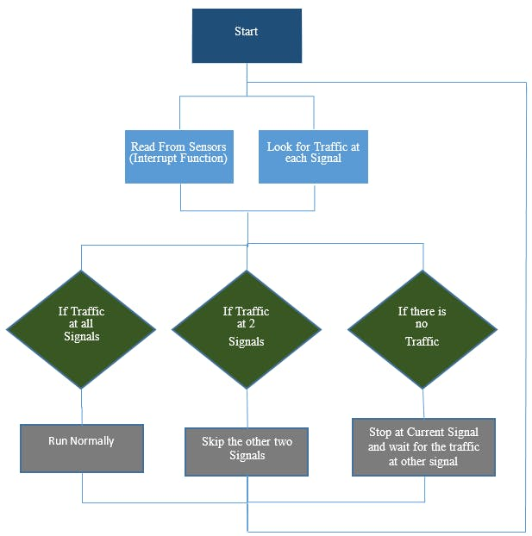
Working

Slide 11
Project Design & Architecture

Slide 12
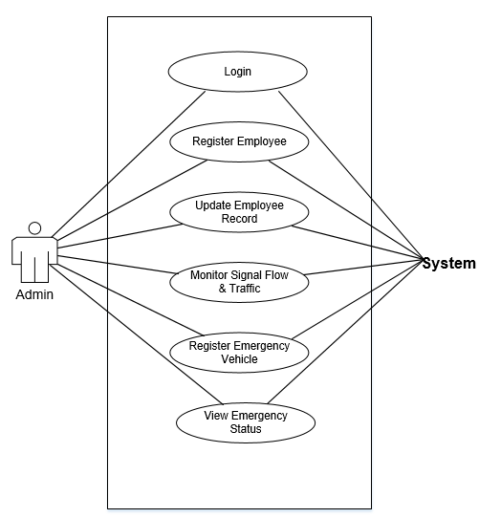
Use Case Diagram(for admin)

Slide 13
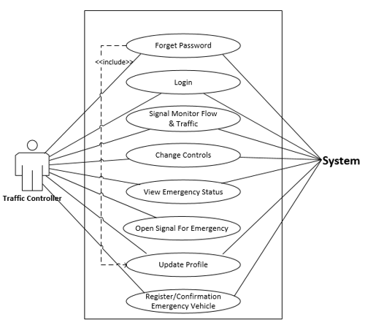
Use Case Diagram(for traffic controller)

Slide 14
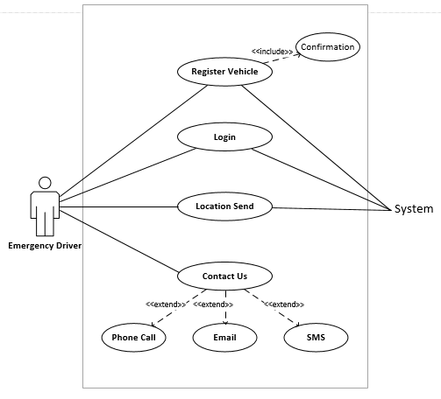
Use Case Diagram(for emergency)

Slide 15
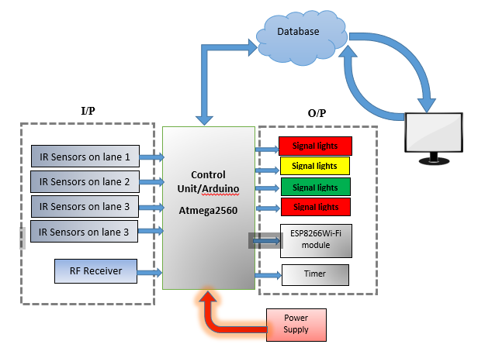
Block Diagram

Slide 16
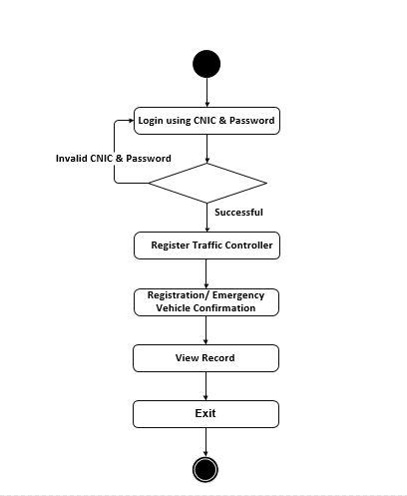
Activity Diagram(for admin)

Slide 17
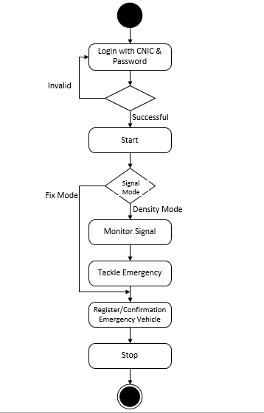
Activity Diagram(for Employee)

Slide 18
Activity Diagram(for Hardware)

Slide 19
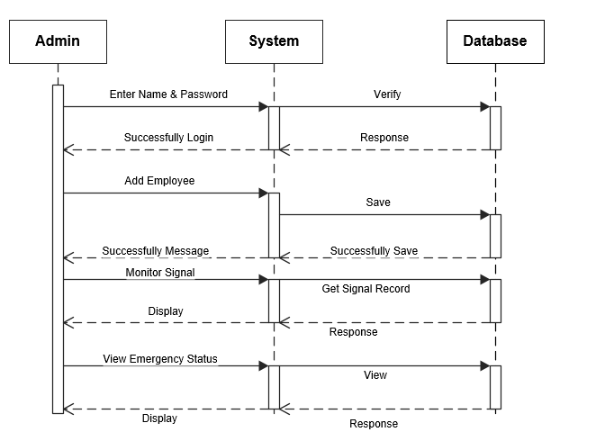
Sequence Diagram(for admin)

Slide 20
Sequence Diagram(for Traffic Control System )

Slide 21
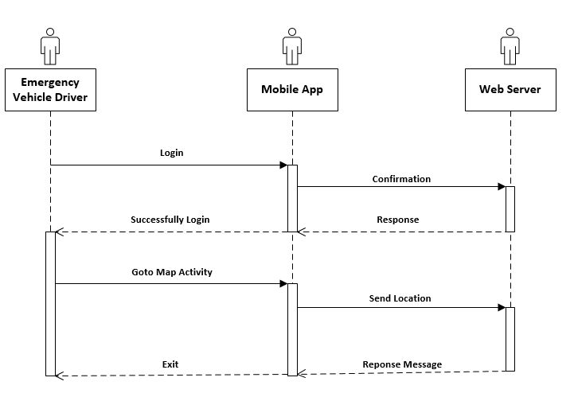
Sequence Diagram(for Emergency Vehicle driver )

Slide 22
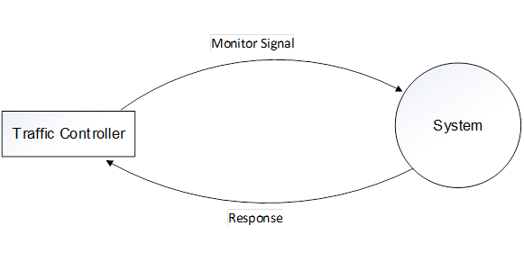
DFD Diagram(Level 0)

Slide 23
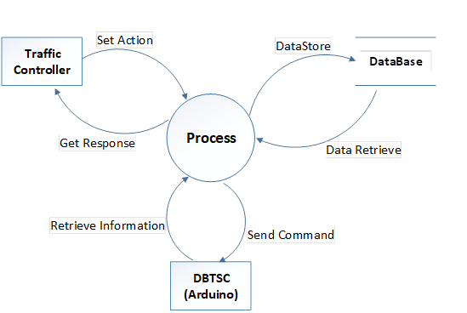
DFD Diagram(Level 0)

Slide 24
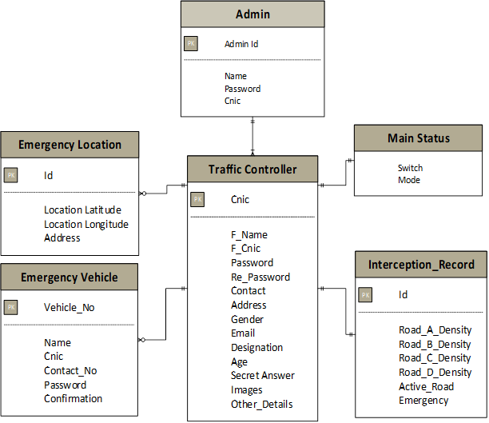
Entity Relationship Diagram (ERD)

Slide 25
User Interface

Slide 26
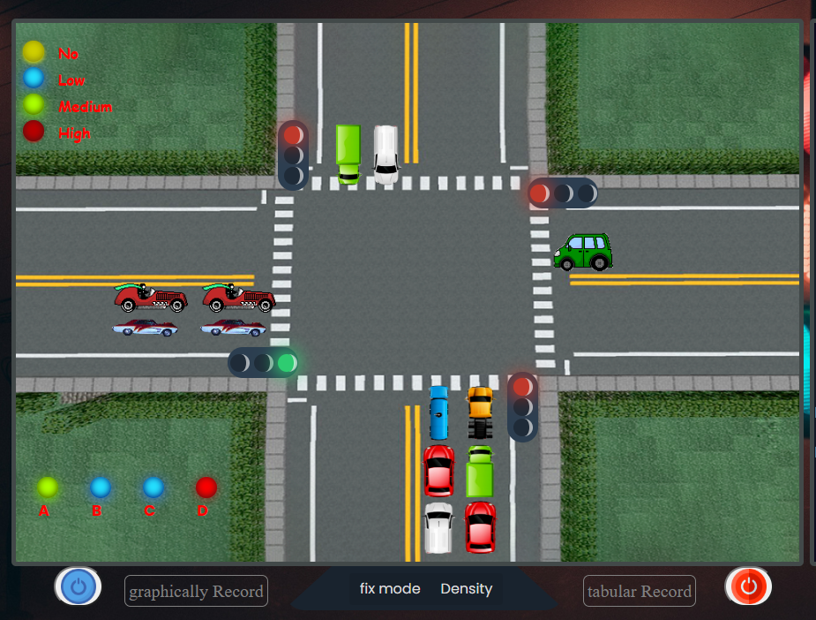
Control Room

Slide 27
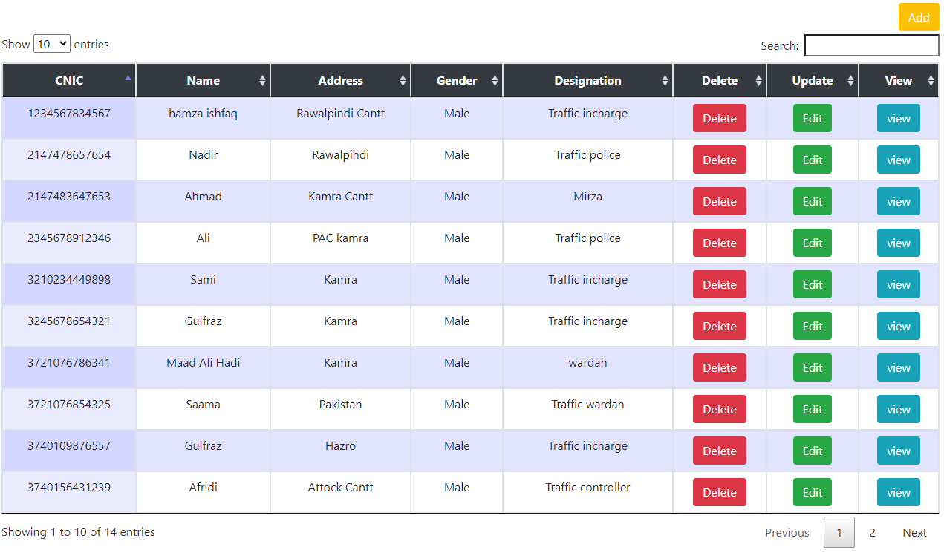
Trafiic Controller record

Slide 28
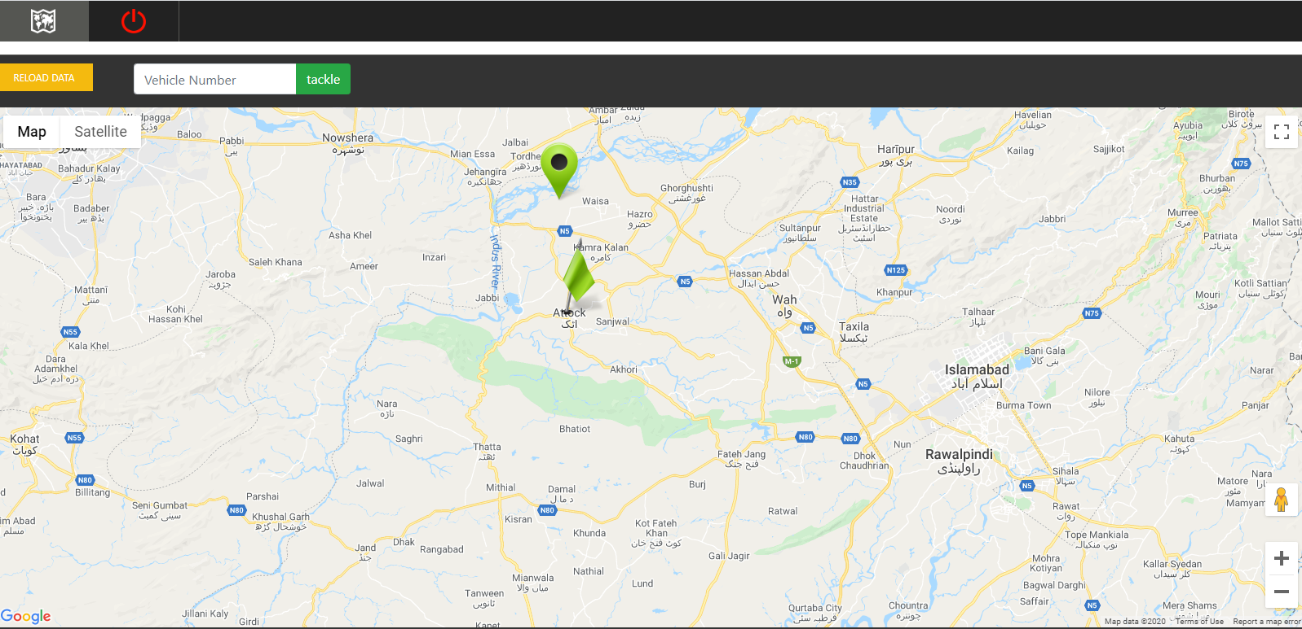
Emergency Status

Slide 29
Testing
System Testing
Unit testing
Functional testing
Integrated Testing
Automated Testing

Slide 30


Slide 31


